Slide 1

Understanding Software Requirements Specification (SRS)
https://github.com/sakysemicolon
[S M Asiful Islam Saky]
https://www.linkedin.com/in/sakysemicolon/

Slide 2
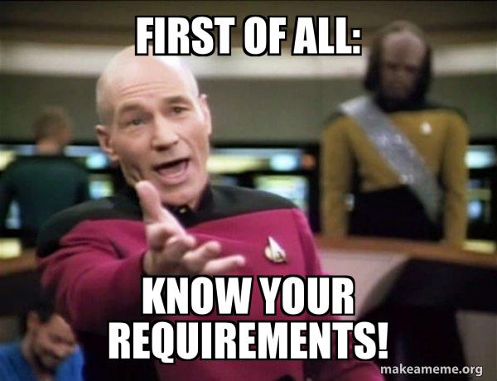

Slide 3
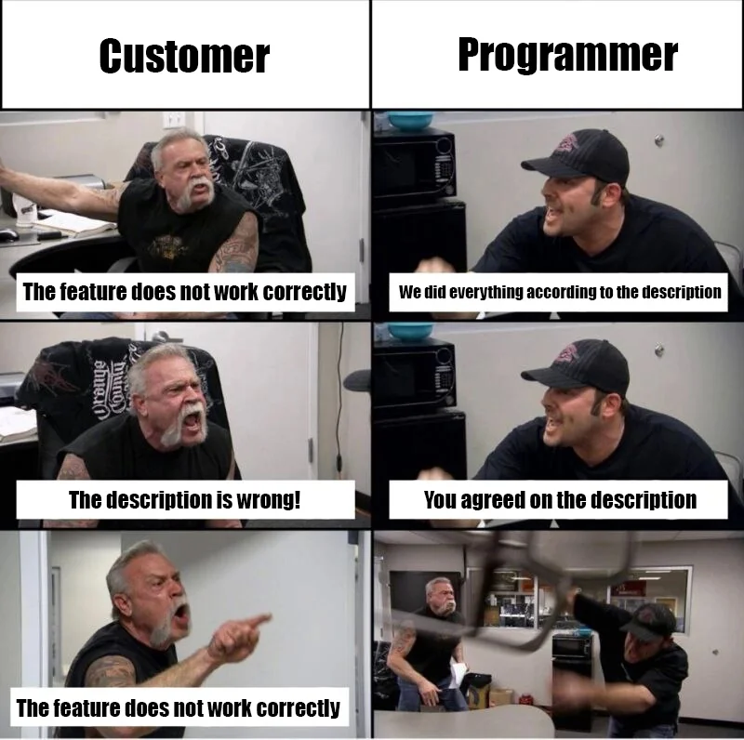

Slide 4


WHOA!
This is
S M Asiful Islam Saky
Mentor, STEAM AIU CLUB
sakysemicolon

Slide 5
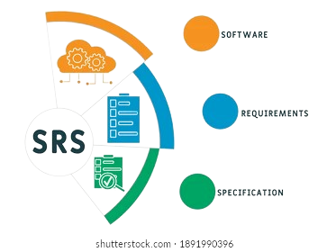
[Agenda]
What is SRS?
Purpose of SRS
Role of SRS
SRS Format
Readers of SRS
Characteristics of SRS
Benefits of SRS
Case Study
Q & A

Slide 6
What is SRS?
SRS is a guide for developers, telling them what to build for a system.
It explains in detail how the system should behave and what users expect from it.
SRS includes both what users need (user requirements) and how the system should work (system requirements).
It describes everything the software will do and how well it should perform.
https://www.linkedin.com/in/sakysemicolon/

Slide 7
Purpose of ‘SRS’ {
01
The SRS document tells exactly what the software will do.
02
It helps to understand all the things needed to make the software and to plan how it will look and work.
03
It also lets the customer give their thoughts and opinions on the software.
}

Slide 8
Role of ‘SRS’
< /1 > {
< Software Requirements Specification (SRS) needs to accurately describe all the things the software must do.
>
}
< /2 > {
< A requirement can be needed because of the job the software needs to do or because of a unique part of the project. >
}

Slide 9
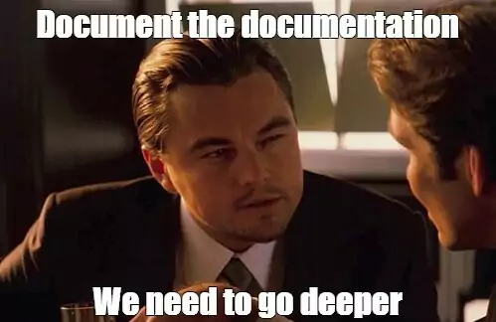
{
[SRS Format]
< Detailed Description of writing an SRS; Template >
}

Slide 10
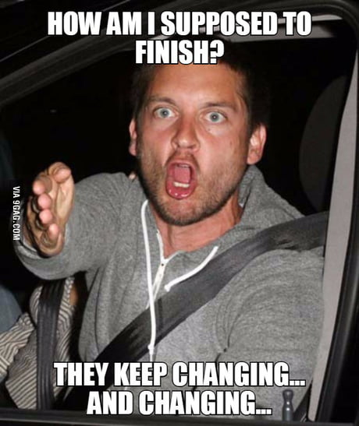

Slide 11
Characteristics of ‘SRS’ {
Correct
Unambiguous
Every requirement given in SRS is a requirement of the software.
Every requirement has exactly one interpretation.
Complete
Consistent
Internal consistency.
Includes all functional, performance, design, external interface requirements; definition of the response of the software to all inputs.
Ranked importance
Essential vs. desirable
}

Slide 12
Title Page
Project title
Version number
Date
Author(s)
Contact information
History
Revision History
Review History
Approval History
List of sections and subsections with page numbers
Table of
Contents

Slide 13
Introduction
Purpose of the document
Scope of the software system
Definitions, acronyms, and abbreviations
Overall
Description
Product perspective
User classes and characteristics
Operating environment
Design and implementation constraints
Assumptions and dependencies
Functual Requirements
Identify and detail the product's design specifications, graphical specifications, requirements for operating systems, and any limitations or constraints.

Slide 14
External Interface
Requirements
User interfaces
Hardware interfaces
Software interfaces
Communication interfaces
Non-functional
Requirements
Security
Capacity
Compatibility
Reliability
Scalability
Maintainability
Usability
Other non-functional requirements

Slide 15
System Feature 1
System Feature 2 and so on...
System Feature
System Models
Use case diagram
State diagram
References and
supporting documents

Slide 16
Readers of SRS {
Business Stakeholders
Project Managers
Developers
Designers
Testers
Regulatory Compliance Officers
Documentation Teams
}
Notes:
1. Business Stakeholders: These are individuals from the client or business side who have a vested interest in the software project's success. They typically focus on highlevel requirements, business goals, and expected outcomes.
2. Project Managers: Project managers are responsible for overseeing the software development process. They review requirements to ensure they align with project timelines, resource allocation, and budget constraints.
3. Developers: Software developers analyze requirements to understand the functionality and features they need to implement. They look for detailed technical specifications, use cases, and system behavior descriptions.
4. Designers: Designers use requirements to create user interface designs and overall system architecture. They focus on usability, user experience, and visual elements based on the specified requirements.
5. Testers: Testers use requirements to develop test cases and validate that the software meets the specified criteria. They look for clear acceptance criteria, functional scenarios, and performance benchmarks.
6. Regulatory Compliance Officers: In industries with regulatory requirements (e.g., healthcare, finance), compliance officers review requirements to ensure the software meets legal and regulatory standards.
7. Documentation Teams: Documentation teams use requirements to create user manuals, technical documentation, and training materials. They focus on translating technical requirements into understandable content for endusers and support staff.

Slide 17

Benefits of ‘SRS’{
• Establish the basis for agreement between the customers and the suppliers on what the software product is to do.
• Reduce the development effort.
• Provide a basis for estimating costs and schedules.
• Provide a baseline for validation and verification.
• Serve as a basis for enhancement.
}

Slide 18
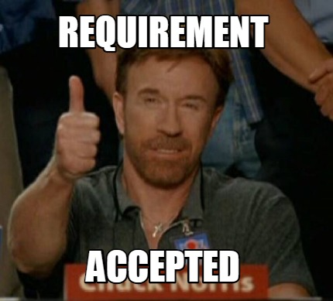
SRS Acceptance {
status= “accepted”;
< SRS acceptance marks a pivotal agreement point, ensuring alignment among stakeholders and setting the foundation for successful software development. >
}

Slide 19


Slide 20

Any Question? {
https://github.com/sakysemicolon
Ask= “asiful.saky@student.aiu.edu.my”
Follow = “www.instagram.com/saky.aiu”
Connect = “www.linkedin.com/in/sakysemicolon”
}

